Slide 1
Disney Challenge
Raven Thornton, Ramsha Zaman, Allison Gibbons

Slide 2
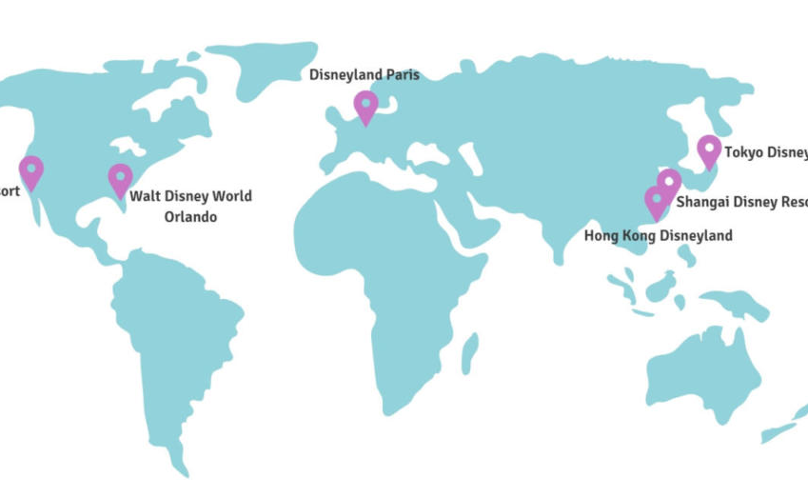
Disney Focus Points Amusement Parks around the World Earnings

Slide 3
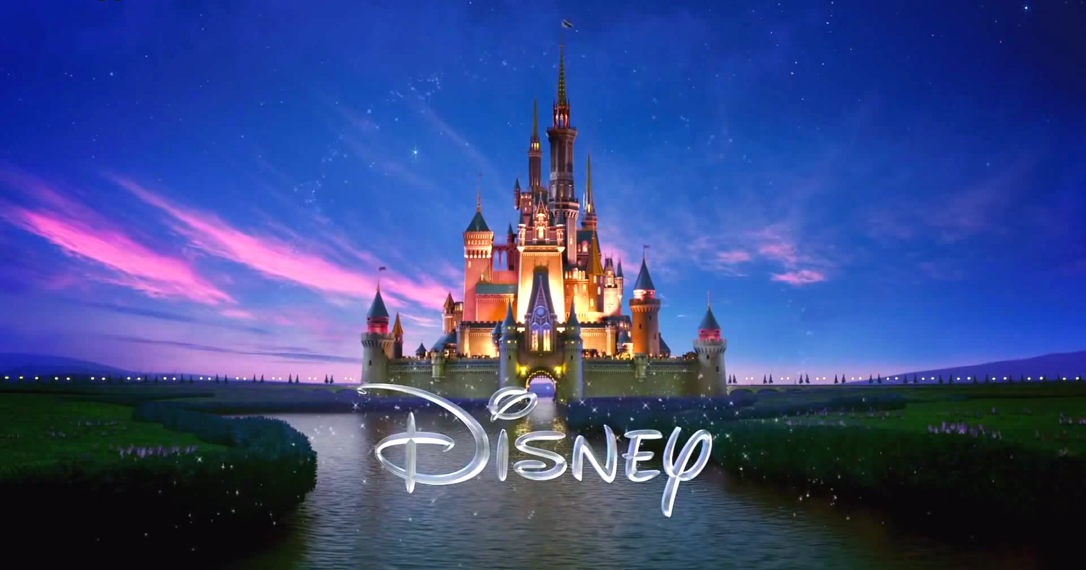
Questions
Overtime, has the population of visitors increased or decreased?
What time of the year are the most popular to visit?
Top five movies that reached highest level of revenue?
Creating a platform or drop down to see which titles and movie details
Actors and roles played
Which attractions within the park are the most popular?

Slide 4
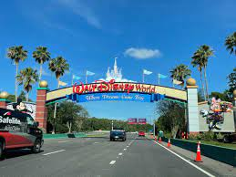
Tools Used
Scraping – Pandas
Database – SQLite
Anime – SVG
Calendar Library

Slide 5
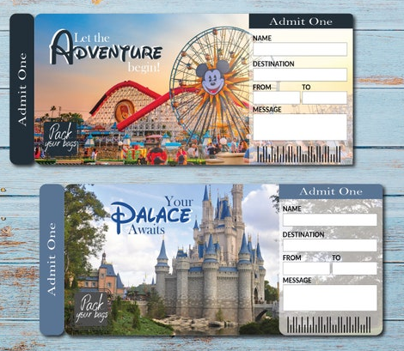
Time for an Adventure

Slide 6
Data for API 1. https://queue-times.com/en-US/parks 2. https://www.the-numbers.com/movies/distributor/Walt-Disney#tab=year

Slide 7
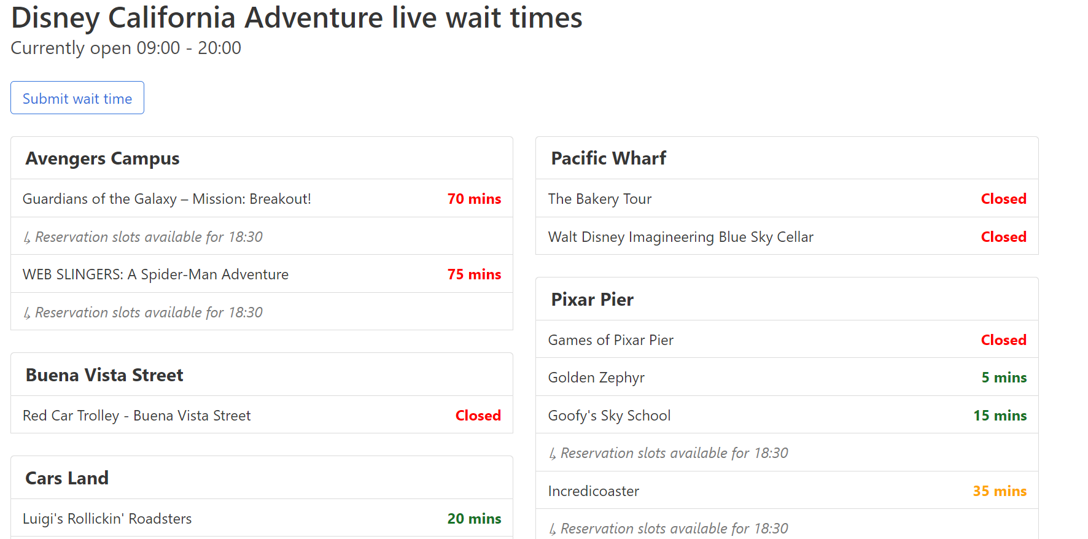

Slide 8
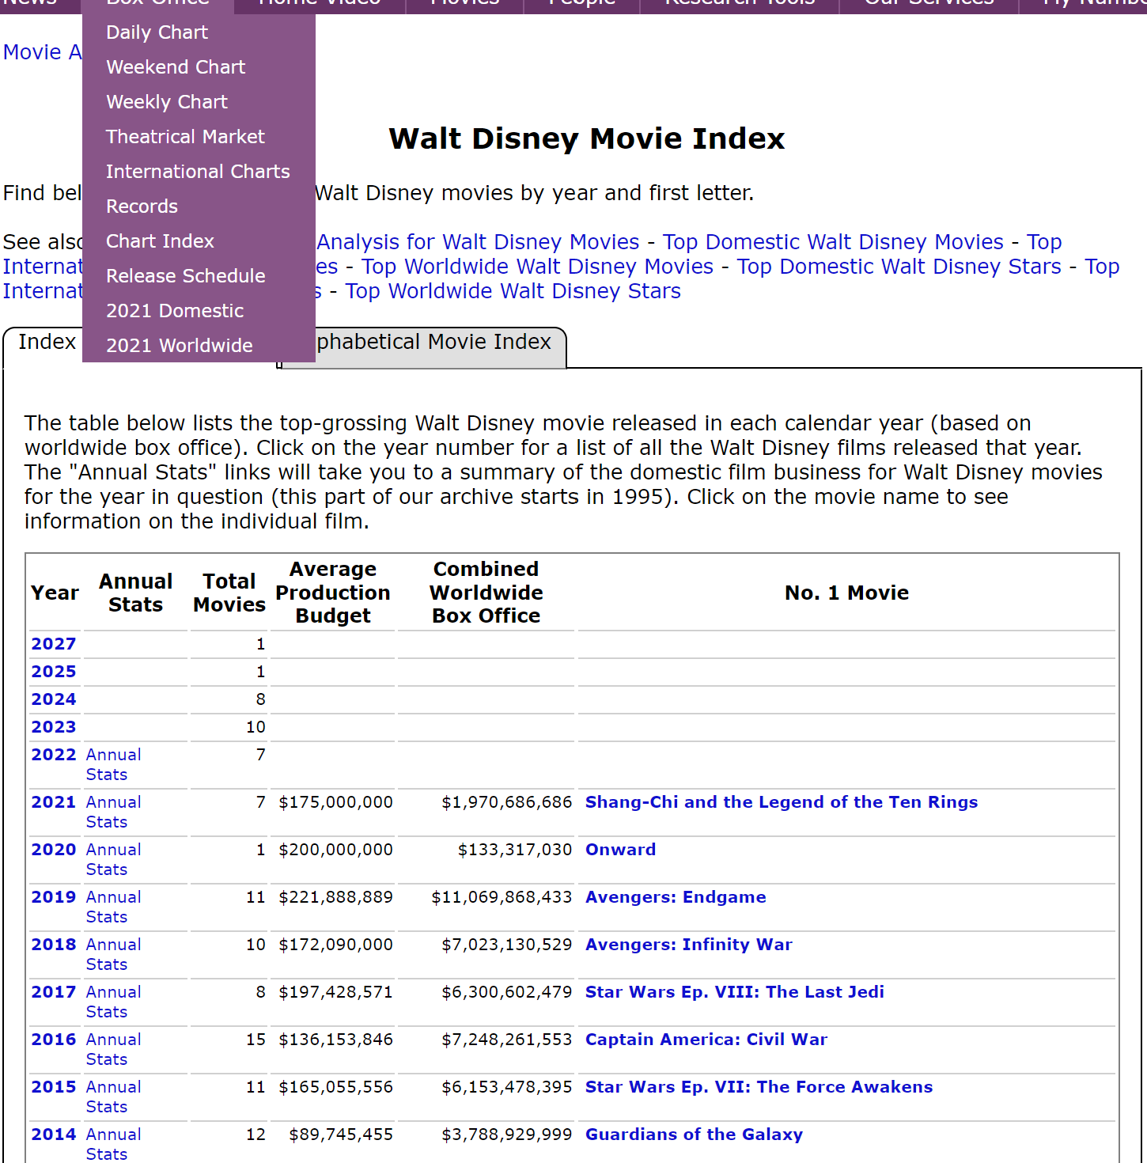

Slide 9

REPO
https://github.com/Ramsha2025/Disney-Challenge.git

Slide 10

JavaScript Libraries
Anime Specifics
Calendar Details

Slide 11

Style
Nav Bar
Fronts
Screen capture
Hidden Mickey

Slide 12

Conclusion
Preparation – Wait time
Tickets – Overtime Increased
Movies – Earnings
Endgame 100Billion+

Slide 13
Work Cited

Slide 14
